Slide 1
Automatic Face Detection & Replacement
Richard Arietta & Daniel Rerucha
CIS581 Fall 2014

Slide 2
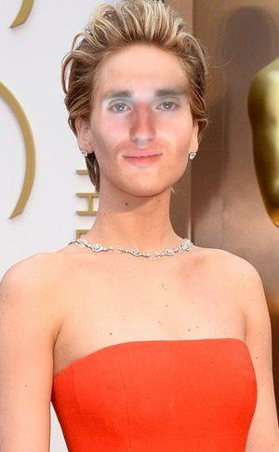
Overview of Algorithm
Program can be divided into two main parts
Part I: Face Detection and Replacement
Part II: Poisson Blending

Slide 3
Overview of Algorithm
Program can be divided into two main parts
Part I: Face Detection and Replacement
Part II: Poisson Blending

Slide 4
Overview of Algorithm
Program can be divided into two main parts
Part I: Face Detection and Replacement
Part II: Poisson Blending

Slide 5
Part 1: Face Detection & Replacement
Program can be divided into two main parts
Part I: Face Detection and Replacement
Part II: Poisson Blending

